Slide 1
Clauses in English
Morphosyntax
Meeting 9 & 10

Slide 2

Outline
Defining a clause
The difference between a phrase and a clause
Types of clauses
How to combine clauses
Compound sentences
Complex sentences :
Noun clause
Adjective clause
Adverbial clause

Slide 3
What is a clause?
A clause is a fundamental unit of grammar in a sentence. It consists of a subject (S) and a verb (V), which work together to express a complete thought or idea.
For example:
The president comes to my university.
  S V
We need water.
  S V

Slide 4
Phrase vs Clause
When it comes to expressing a complete thought, a clause falls between a phrase and a sentence. In many cases, a clause can function as its own sentence. A phrase, in contrast, cannot. Here is a quick look at the difference between a phrase and a clause:
For instance:
Phrase: A white cat
Clause: I found a white cat
consist of head and modifier
consist of subject and predicate

Slide 5
Types of Clause
There are two types of clauses: Independent clause and dependent clause
Independent clauses : An independent clause is a clause that can stand on its own as a distinct sentence. Take a look at these examples:
I loke eating cookies.
The kids ate lunch at the school.
Dependent clauses : These clauses are not a complete sentence. Dependent clauses are sometimes known as subordinate clauses. As their name implies, these clauses depend on independent clauses to clearly express ideas. Here are a few examples of dependent clauses:
When I grow up
Although he reads well
The cat that was hiding
What should you do to turn the dependent clause above into full sentences?

Slide 6
When I grow up, I want to be a superstar.
Although he can read well, he hardy understands the meanings.
I searched through the basement and found the cat that was hiding.
Practice : make these dependent clause into full sentences:
What you did last summer
What you are talking about
When the accident happened
How you are feeling
That I know nothing
Who is travelling to Europe
Whose house was built by artificial intelligence
Because I am ill

Slide 7
Read the following passage and identify the clause in it.
Decide whether each one is a dependent or an independent clauses.
Despite its wide range of applications in various domains, the use of ChatGPT has reignited the debate on the potential and risks associated with AI technologies.
The introduction of ChatGPT in education has sparked debates about its potential implications for education.
While advocates of ChatGPT praise its ability to support education for instance in terms of providing adaptive and personalised environments, some scholars are concerned about the ethical considerations of ChatGPT, as well as its potential negative effects on assessment practices, scientific integrity, and students’ higher-order thinking skills.
In addition, several editorials have been written about how ChatGPT can influence education.
These kinds of scientific debates are common place when new technologies are introduced
into education, as they often disrupt traditional practices and require teachers to adapt to their potential benefits and drawbacks.

Slide 8
How to combine clauses
When you write a sentence with more than one independent clause.
Every sentence must include at lease one independent clause. Other clauses can be dependent clause.
A sentence that includes two or more independent clause is known as a Compound sentence (talk it later).
In a compound sentence, the clauses are joined by a comma paired with coordinate conjunction (FANBOYS), a semicolon, or a colon.
For example:
I love drinking soda, but I know it’s bad for my teeth.
Maria loved hosting dinner parties; her friends enjoyed her cooking.
We danced until the band finished playing: they played until midnight.

Slide 9
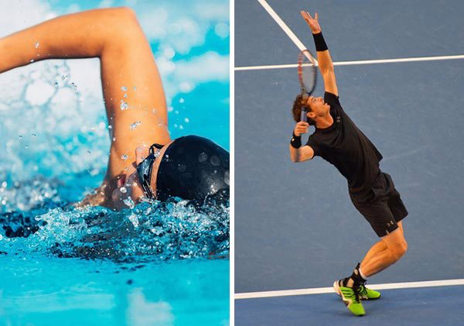
COMPOUND SENTENCE:
COORDINATING CONJUNCTIONS
Tom swims, and Mary plays tennis.
Clause 1 Clause 2
Independent Independent

Slide 10
COMPOUND SENTENCE:
CONJUNCTIVE ADVERBS
Note: Semicolon
before conjunctive
adverb and comma
after conjunctive adverb!
MOREOVER
HOWEVER
OTHERWISE
THEREFORE
Example:
Aldi is handsome; moreover, he is rich.
Clause 1 Clause 2
Independent Independent

Slide 11
Conjunctive Adverbs “float”
Conjunctive adverbs are sometimes called “floating” adverbs because they can be positioned at the beginning, in the middle, or at the end of a clause.
Examples:
Aldi is handsome; moreover, he is rich.
Aldi is handsome; he is, moreover, rich.
Aldi is handsome; he is rich, moreover.
11

Slide 12
Semicolons
“If the relation between the ideas expressed in the main clauses is very close and obvious without a conjunction, you can separate the clauses with a semicolon” (Little, Brown Handbook, 9th Edition, p. 361).
Rony has benefited from his exercise program; he is slim and energetic.

Slide 13
Complex Sentences
A sentence that includes an independent clause and one or more dependent clauses is known as a complex sentence, and a sentence that includes two or more independent clauses and at least one dependent clause is known as a compound-complex sentence. In either of these kinds of sentences, the subordinating conjunction signifies the beginning of the dependent clause.
The fun can begin now that the clown is here.
While we slept, the plane reached its destination.
Before you leave, remember to take a goodie bag!
The pool is open daily until the temperature drops.
As you can see in these examples, when the dependent clause comes first, it needs to be followed by a comma.

Slide 14
Three types of dependent clause
Subordinating conjunctions are not the only way to add a dependent clause to a sentence.
Dependent clauses can also start with :
NOUN CLAUSES
ADJECTIVE CLAUSES
ADVERB CLAUSES
14

Slide 15
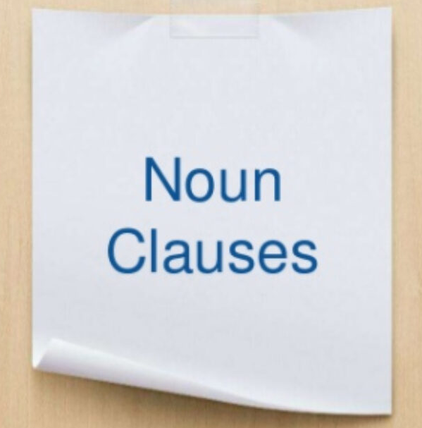
What is a Noun Clause ???
A noun clause is a subordinate clause that does the work of a noun in a sentence.
Example:
I know that she left for dance class in the morning.
Main Clause
Noun Clause
How to identify a noun clause ? By asking who or what questions in a given sentence.
We need to ask a question to find out what the subject knows.
Question : I know what ?
Answer : That she left for dance class in the morning.
The answer to this question is the subordinate clause. It is the noun clause of the sentence.

Slide 16
A noun clause usually begins with words like :
That
What
If
Whether
How
Where
Who
Whom
Whose
Why
However
Whatever
Wherever
Whoever
,etc
For example:
She does not know where he went.
Whether he will win is undecided.
Whatever you do, do it well.

Slide 17
A noun clause acts as a noun in a sentence. It can function in different ways.
Function of Noun Clause | Example
As subject of a Verb | What route we take is our choice. How the documents went missing is anyone’s guess.
As object of a Verb | I thought that we would watch a movie. Sometimes people wish that they could go back in time.
As object of a Participle | Discovering that it was right, I jumped with joy. Hoping that she loved chocolates, Joshua bought a box of silver queen.
As object of a Preposition | Sometimes I think of what he said.

Slide 18
Let us look at more function of the noun clause.
Function of Noun Clause | Example
As subject of an Infinitive | Jim wants to know where his friends are.
As an Adjective Complement | The girls were happy that Saturday was a holiday.
As a Complement of a verb of Incomplete Predication. | The problem is that we do not have a leader. My belief is that we will win.

Slide 19
ADJECTIVE CLAUSES
Dependent clauses that must be joined to independent clauses
Describe nouns and pronouns
Often placed in a sentence right after the noun they describe
Add details to sentences by functioning as adjectives
19

Slide 20
ADJECTIVE (RELATIVE) CLAUSES
Adjective clauses begin with one of the relative pronouns such as who, whom, whose, where , that, which.
Also called relative clauses.
20

Slide 21

Relative Pronouns & Relative Clauses
Who
Refers to people, used as subject in the clause
The lady who teaches in Political Science department is my mentor.
(Relative pronoun as the subject of the clause)
21

Slide 22
Relative Pronouns & Relative Clauses
Sally, who(m) he knew, arrived yesterday.
(Relative pronoun as the object of the clause)
The student of whom he spoke was a foreigner.
(Relative pronoun as the object of a preposition)
Whom
Refers to people, used as object or object of preposition
(Formal grammar recommends whom, not who, in the object position)
22

Slide 23
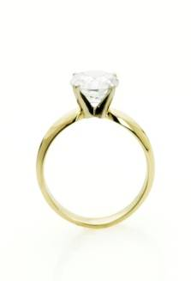
Relative Pronouns & Relative Clauses
The watch which Ken bought was expensive.
The ring that Jamie wears is from her husband.
The lion that escaped last night was captured.
(Note: the sentence using which is more formal than the one with that)
Which or that
Refers to things, animals
23

Slide 24
Relative Pronouns & Relative Clauses
Whose
Refers to possession/ownership
The father whose child is missing is frantic!
The company whose manager has resigned is in dire straits.
24

Slide 25
Relative Pronouns & Relative Clauses
Where
Refers to a place
It cannot be a subject.
It can be omitted but a preposition (at, in, to) usually must be added.
The house where he stays is old .
The house in which he stays is old.
The house which he stays in is old.
The house that he stays in is old.
The house he stays in is old.
25

Slide 26
Adjective Clauses:
Restrictive & Non-restrictive Clauses
Restrictive Clauses | Non-restrictive Clauses
are necessary for identification—tell exactly which thing or person | are interesting with extra information -but don’t identify or tell “which one”
DO NOT have commas around clause | ALWAYS have commas around clause
Also known as identifying or defining clauses | Also known as non-identifying or non-defining clauses

Slide 27
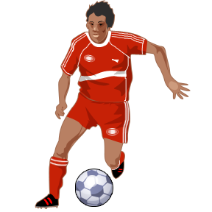
Restrictive Adjective/Relative Clauses
Examples:
The soccer player who scored the goal is from Liverpool.
The girl that borrows my book is my cousin.
The district where I live is near the post office.
27

Slide 28

Non- Restrictive Adjective/Relative Clauses
Examples:
Ms. Tan, who is my English tutor, went to Korea last winter.
My dog, which is barking, is in the backyard.
William decided to reject the offer, which upset his manager.
28

Slide 29

Compare Restrictive & Non-restrictive Clauses
1. My brother who lives in Berlin is an accountant.
This sentence suggests that I have more than
one brother. “Who lives in Berlin” identifies
this brother, not the one who lives in Indonesia.
2. My brother, who lives in Berlin, is an accountant.
This sentence suggests that I only have one brother,
“who lives in Berlin”.
29

Slide 30
Which is logically correct?
1. My father, who is a taxi driver, doesn’t like to exercise.
2. My father who is a taxi driver doesn’t like to exercise.
Correct
(This suggests you have more than one father!)
30

Slide 31
Adverb Clause
One type of subordinate clause is adverb clause. like adverbs, adverb clauses describe verb, an adjective, or an adverb. Adverb clauses answer the following questions:
How?
When?
Where?
Why?
To what extent?
How much?
How long?
Under what conditions?

Slide 32
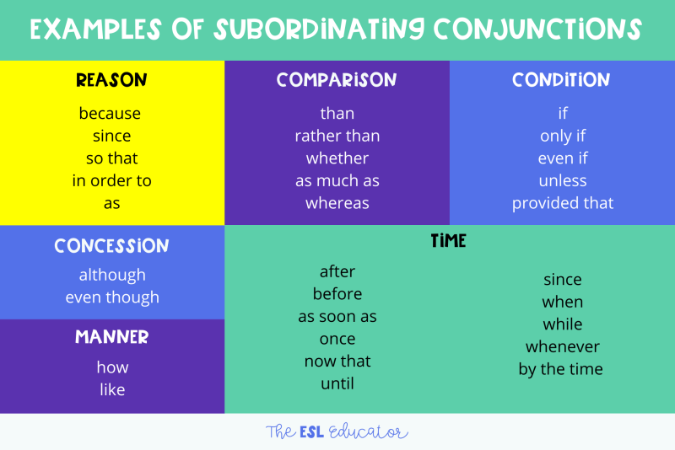
Subordinate Conjunction

Slide 33
Identify Adverb Clause
To find an adverb clause, look for the following things in a sentence. if you can answer yes to the all the questions below, you have probably found an adverb clause.
Can you find a connecting word (such as after, because, or than)
Do a subject and its verb follow the connecting word?
Does the group of words contain a connecting word, a subject, and its verb?
Does the word group describe a verb, and adjective, or an adverb?

Slide 34
Position?
Adverb clauses may be placed in various positions in sentences. when an adverb clauses comes at the beginning of a sentence, it is usually following by a comma.
There are two possible structure :
1. Adverb + Subject + Verb (,) Subject + Verb
2. Subject + verb (no punctuation ) adverb + subject + verb

Slide 35

Adverb Clause – Time Connection
1. After :
After present, future
After I celebrate my graduation, I will call my parents.
After past perfect, past
After I have celebrated my graduation, I called my parents.
2. Before
Future before present
I will celebrate my graduation before I call my parents.
Past perfect before past
I had celebrated my graduation before I called my parents.

Slide 36
Identity the Adverbial Clause
After Tim saved fifty dollars, he put it in the bank.
The VCR will not work if we hook up the cords incorrectly.
The crowd stood for the national anthem before the football game began.
As long as they are quiet, the children can watch the movie with us.
There were muddy footprints wherever Natalie had walked.
The delicate hummingbird flapped its wings as it flew near the flowers.
Because Maria like comic book, she has a large comic-book collection.
Pumpkin seeds are tastier if you toast them.
When the river flowed through this area, the water created this valley.
Because Willish has studied the fifty states, he knows special facts about each one.
If Megan runs in the race this weekend, will she finish in first place?
The ground was gray and slushy where a field of snow had not melted yet.

Slide 37

Thank you
Any questions?

